Slide 1
MongoDB Scan
Sreejith P Nair

Slide 2
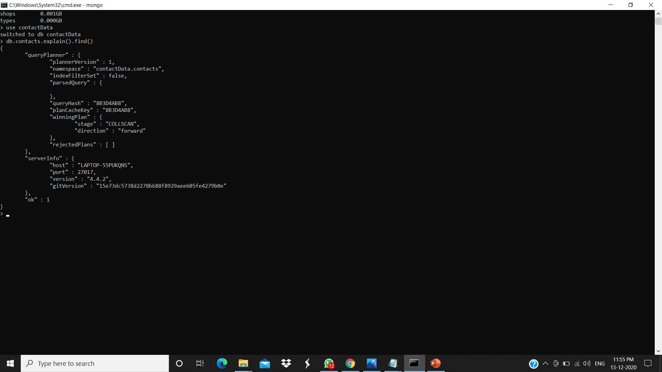
Collection Scan

Slide 3

Index Scan

